Slide 1
GUI AI Learning Platform Design
TSDV
2021 年 02月 18 日

Slide 2



Main window
AI Learning Platform
Transfer Learning
Genneration Management

Slide 3
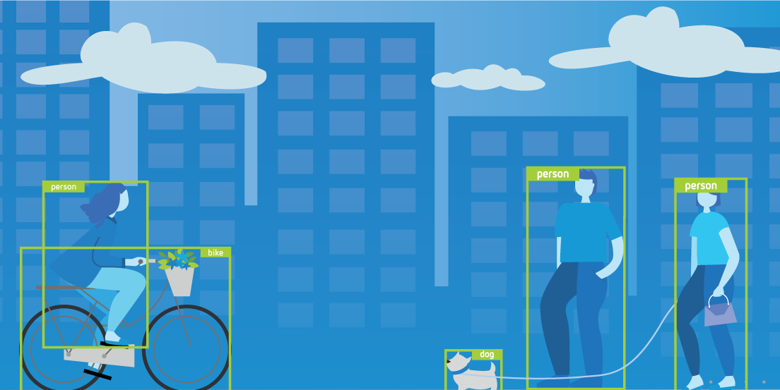
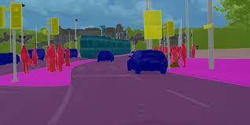

Transfer Learning window
Object-Detection Segmentation
Object Detection
Segmentation
Object detection combines classification and localization to determine what objects are in the image or video and specify where they are in the image. It applies classification to distinct objects and uses bounding boxes.
Segmentation identifies parts of the image and understanding what object they belong to. Segmentation lays the basis for performing object detection and classification.

Slide 4
Transfer Learning window
Object-Detection Segmentation
Train
Evaluate
Interference
Prune
Object Detection
Segmentation
Object detection combines classification and localization to determine what objects are in the image or video and specify where they are in the image. It applies classification to distinct objects and uses bounding boxes.
Segmentation identifies parts of the image and understanding what object they belong to. Segmentation lays the basis for performing object detection and classification.

Slide 5

Transfer Learning - Segmentation
Train Function
Object-Detection Segmentation
Genneral Configuration
Architectures Model
MaskRCNN
MaskRCNN
Input dataset
./voc2012
The Transfer Learning Toolkit for Intelligent Video Analytics Guide provides instruction on using transfer learning for video and image analysis.
Output Model
Git/model/MaskRCNN.pth

Slide 6

Transfer Learning - Segmentation
Train Function
ObjectDetection Segmentation
MaskRCNN configuration
CNN network
Backbone
Number classes
RPN parameters
RPN Anchor
RPN fg_iou
RPN pretrain
RPN bg_iou
RPN post train
RPN batch
Box parameters
Box detection
Box batch
Box fg_iou
Box positive
Box bg_iou

Slide 7
Transfer Learning - Segmentation
Train Function
ObjectDetection Segmentation
MaskRCNN configuration
CNN network
RPN parameters
Box parameters
Backbone
RPN Anchor
Box detection
Number
classes
RPN pretrain
Box fg_iou
RPN post train
Box bg_iou
RPN fg_iou
Box batch
RPN bg_iou
Box positive
RPN batch

Slide 8
Transfer Learning - Segmentation
Train Function
Model is be training

Slide 9
Transfer Learning - Segmentation
Train Function
Successfull case
Failure case
Model is trained seccessfully
Model is trained fail
100 %
>Detail log
[1, 2000] loss: 2.272
[1, 4000] loss: 1.926
[1, 6000] loss: 1.724
[1, 8000] loss: 1.620
[2, 2000] loss: 1.407
[2, 4000] loss: 1.392
[2, 6000] loss: 1.381
Finished Training
>Detail log
NameError: name 'Image' is not defined

Slide 10
Genneration Management Window
Clone Checkout Push Convert-dataset Help
Dataset information
Dataset | Date modified
VOCdevkit/VOC2012 | 2021/02/18
VOCdevkit/VOC2013 | 2021/02/18
Trained model
Model/maskrcnn_res50.pth | 2021/02/18
Model/maskrcnn_res101.pth | 2021/02/18

Slide 11
Genneration Management Window
Clone Function
Clone Checkout Push Convert-dataset Help
Git Repository
Output Folder
…

Slide 12
Genneration Management Window
Clone Function
Git repositoy is being cloned

Slide 13
Genneration Management Window
Clone Function
Successfull case
Failure case
Git repositoy is cloned successfully
Git repositoy is cloned fail
100 %
>Detail log
Git clone http://server.10.114.45.144:~/git/project.git
>Detail log
Git clone http://server.10.114.45.144:~/git/project.git
Error repository is not exist

Slide 14
Genneration Management Window
Checkout Function
Clone Checkout Push Convert-dataset Help
Git Branch

Slide 15


Genneration Management Window
Checkout Function
Successfull case
Failure case
Git branch is checkouted fail
Git branch is checkouted successfully
>Detail log
Error train branch is not exist

Slide 16
Genneration Management Window
Push Function
Clone Checkout Push Convert-dataset Help
Dataset
Trained model
Dataset information
Dataset | Date modified
VOCdevkit/VOC2012 | 2021/02/18
VOCdevkit/VOC2013 | 2021/02/18
Trained model
Model/maskrcnn_res50.pth | 2021/02/18
Model/maskrcnn_res101.pth | 2021/02/18

Slide 17
Genneration Management Window
Push dataset Function
Clone Checkout Push Convert-dataset Help
Dataset
Git Branch

Slide 18
Genneration Management Window
Push trained Function
Clone Checkout Push Convert-dataset Help
Trained Model
Git Branch

Slide 19
Genneration Management Window
Push Function
Git repositoy is being pushed

Slide 20
Genneration Management Window
Push Function
Successfull case
Failure case
Data is pushed successfully
Data is pushed fail
100 %
>Detail log
Data is pushed successfully
>Detail log
Error train branch is not exist

Slide 21
Genneration Management Window
Convert Function
Clone Checkout Push Convert-dataset Help
Dataset
Output folder

Slide 22
Genneration Management Window
Convert Function
Dataset is being converted

Slide 23
Genneration Management Window
Convert Function
Successfull case
Failure case
Dataset is converted successfully
Dataset is converted fail
100 %
>Detail log
Data is converted successfully
>Detail log
Error dataset is converted fail

Slide 24
Genneration Management Window
Help Function
Clone Checkout Push Convert-dataset Help
SSH key
Dataset information
Dataset | Date modified
VOCdevkit/VOC2012 | 2021/02/18
VOCdevkit/VOC2013 | 2021/02/18
Trained model
Model/maskrcnn_res50.pth | 2021/02/18
Model/maskrcnn_res101.pth | 2021/02/18

Slide 25
Genneration Management Window
Help function
SSH Key
AAAkldklasdlaskldklasdlsafas
Fasfasfsflasflkasklfklsafasffsafsfasffsafkrriowioqworioasds
sdadasdsadsad

